Slide 1
Assessing Algorithmic Fairness with Unobserved Protected Class Using Data Combination
Xiaojie Mao
Department of Statistics and Data Science
Cornell University

Slide 2
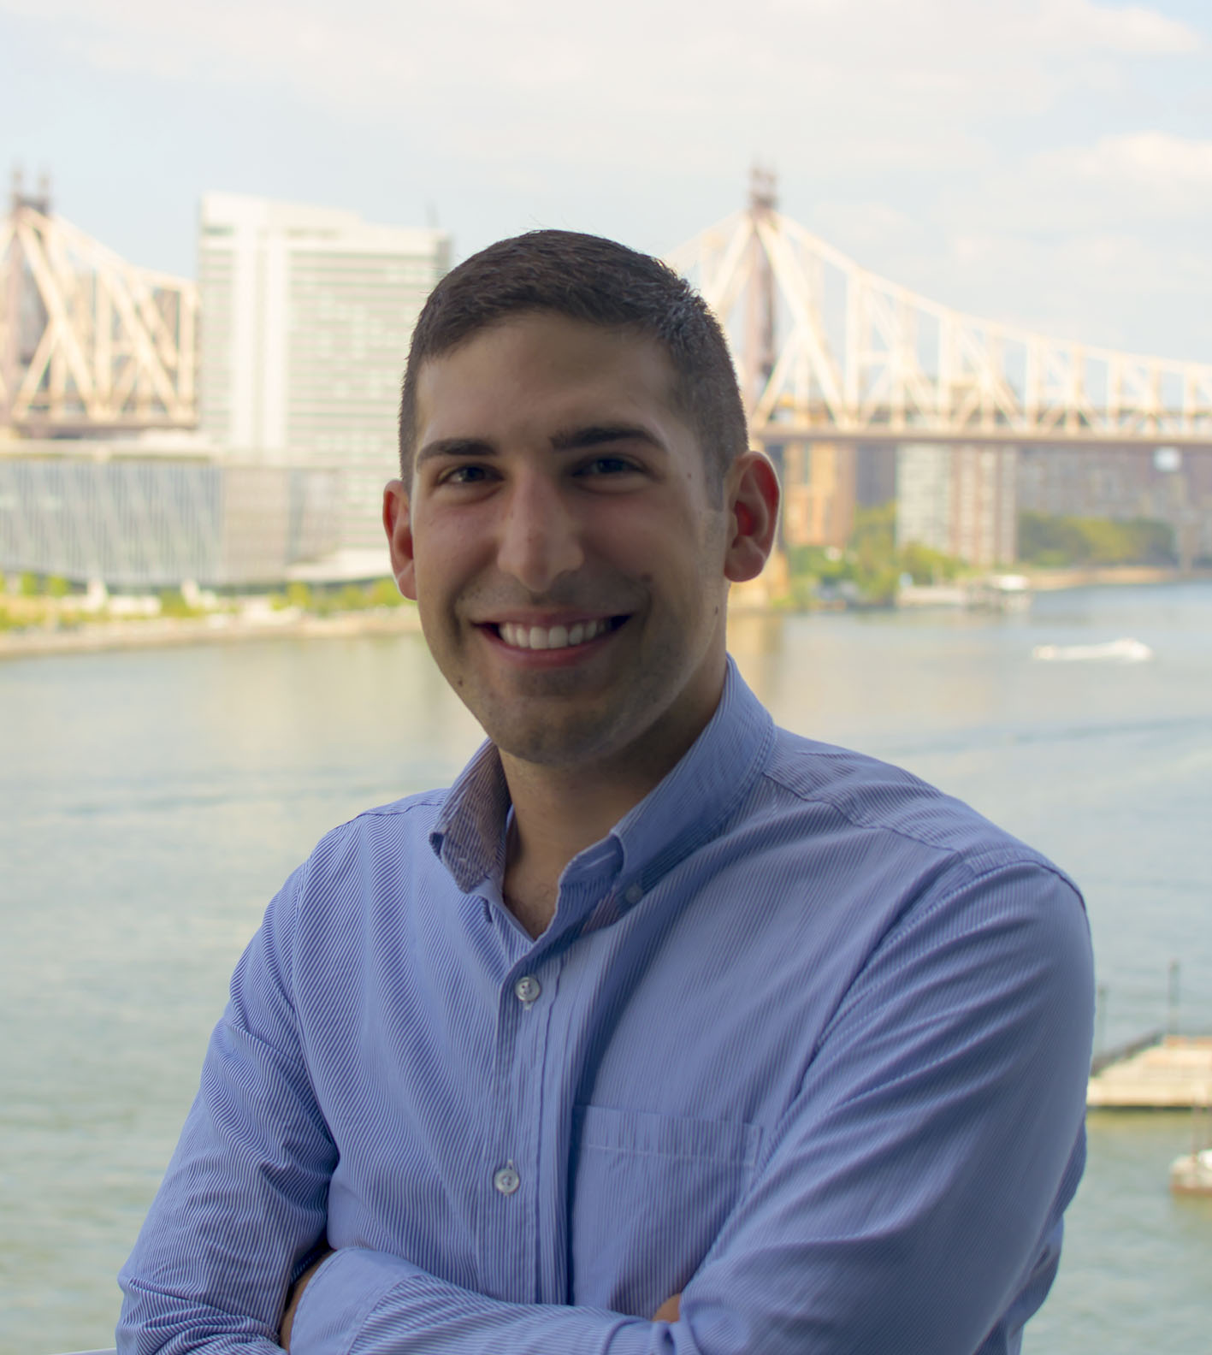
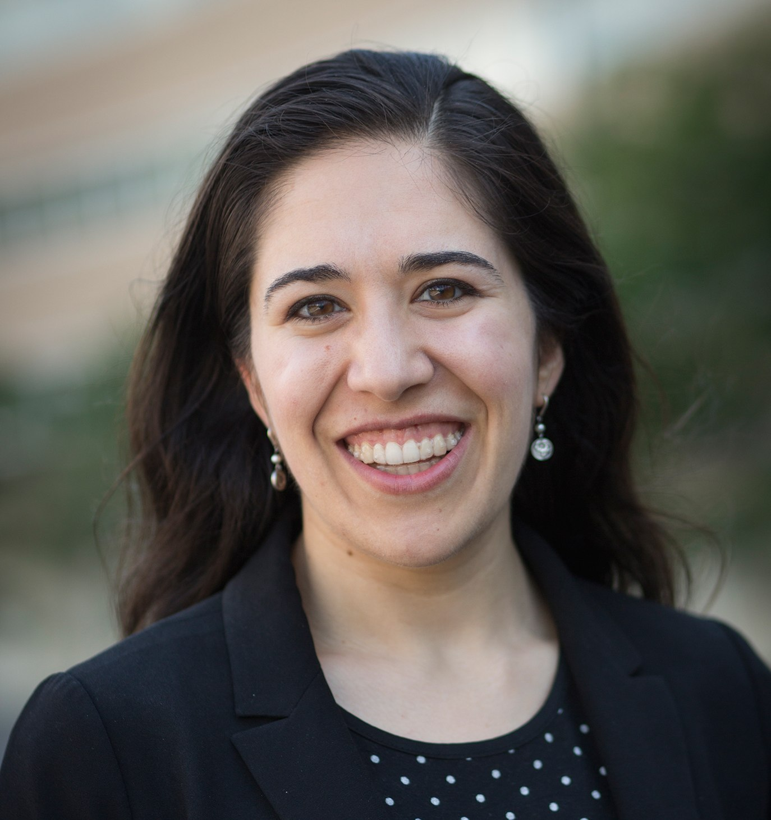
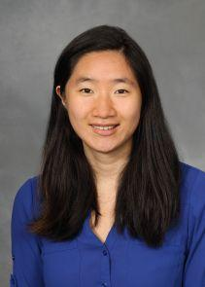
Based on
Chen, Kallus, Mao, Svacha and Udell. “Fairness under unawareness: Assessing disparity when protected class is unobserved.” ACM FAT*, 2019.
Kallus, Mao, and Zhou. “Assessing Algorithmic Fairness with Unobserved Protected Class Using Data Combination.” Major revision in Management Science Special Issue on Data-Driven Prescriptive Analytics. 2019.
Nathan Kallus
Madeleine Udell
Angela Zhou
Notes:
30s

Slide 3
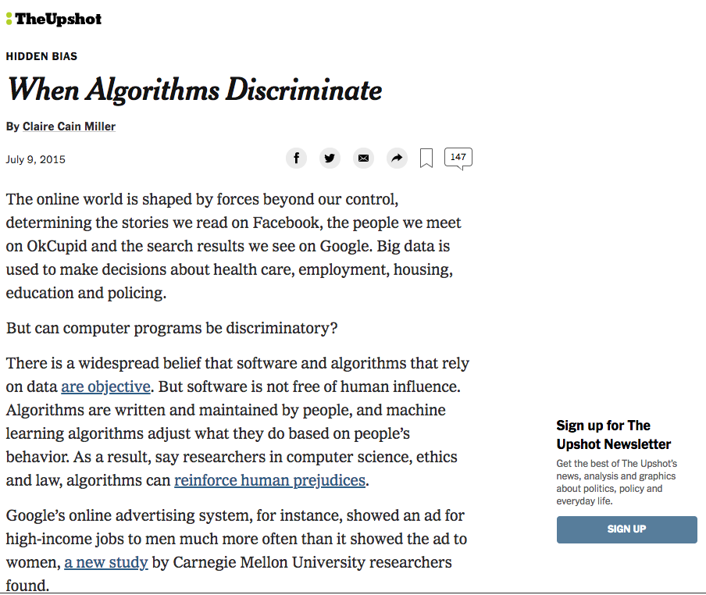
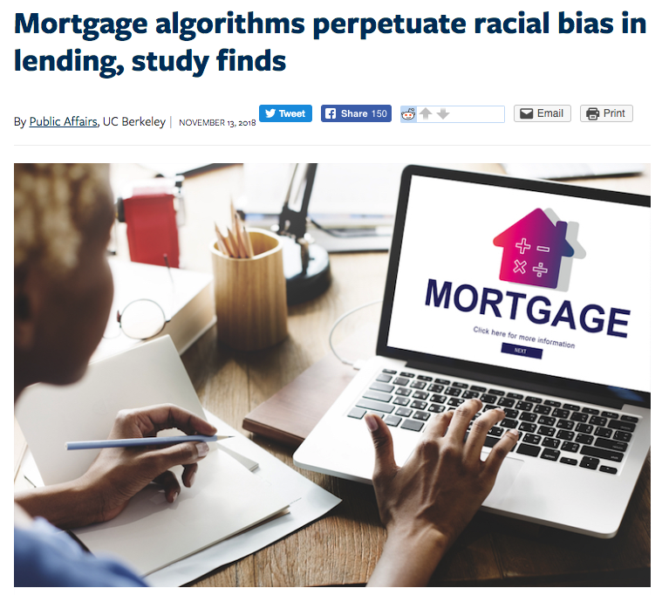
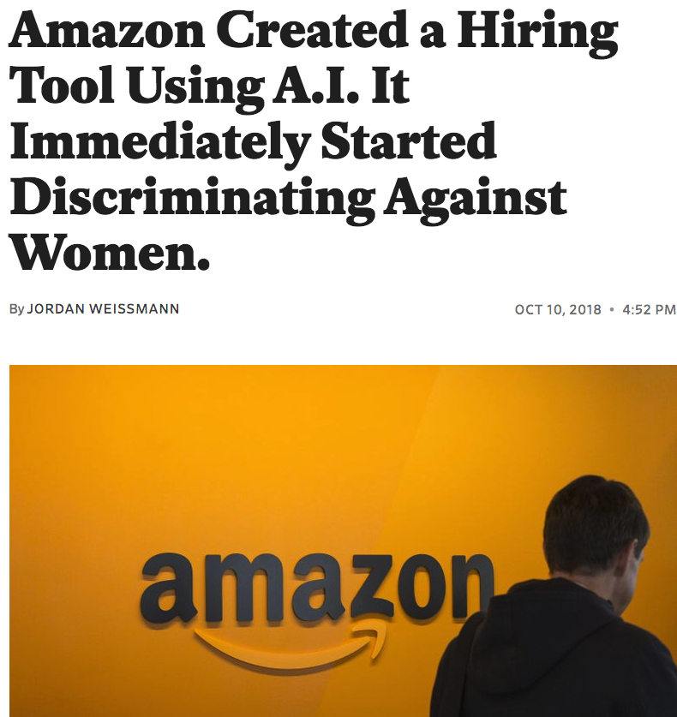
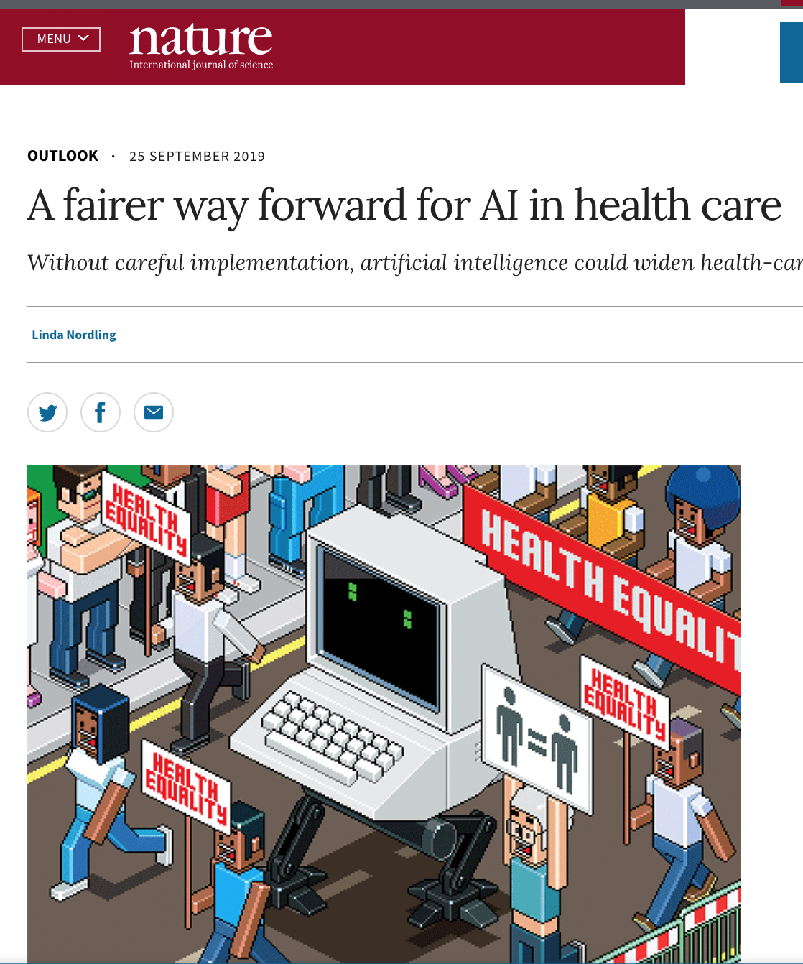

Slide 4
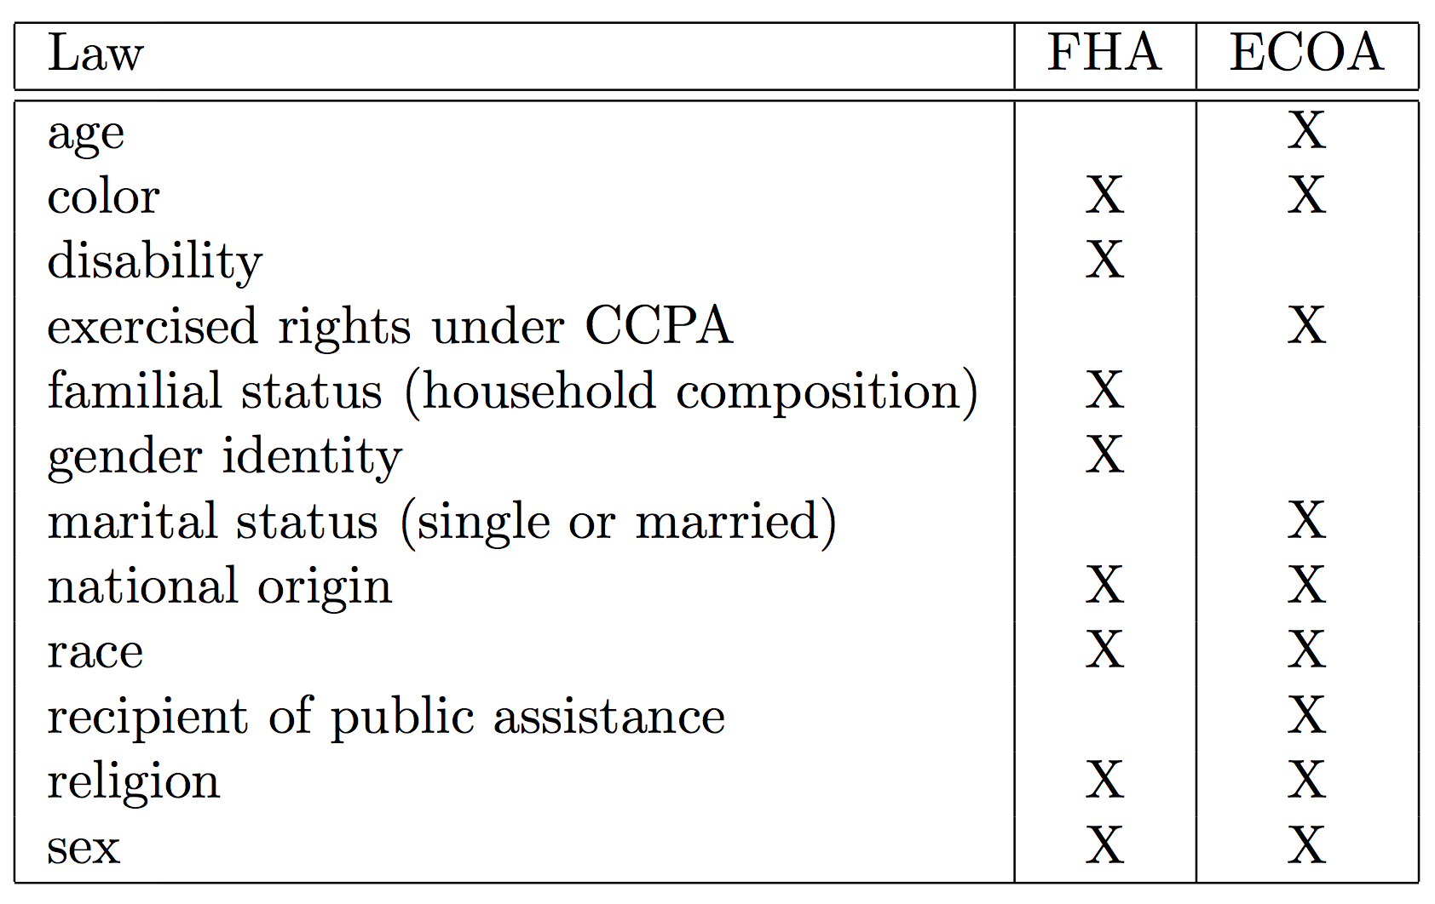
Protected class

Slide 5
Two doctrines of discrimination
Disparate Treatment
Explicitly treat an individual differently based on class membership.
treatment disparity
Disparate Impact
Adversely affect members of one protected class more than the other even if by an ostensibly neutral policy.
outcome disparity

Slide 6
Two doctrines of discrimination
Disparate Treatment
Explicitly treat an individual differently based on class membership.
treatment disparity
Disparate Impact
Adversely affect members of one protected class more than the other even if by an ostensibly neutral policy.
outcome disparity

Slide 7
Unobserved protected class
Healthcare: Health plans lack race/ethnicity data on most of their enrollees;
Financial industry: illegal to collect race and ethnicity for non-mortgage products.
How to measure outcome disparity
when protected class is unobserved?
Weissman et. al. 2011, Frement et. al. 2016
2. Zhang 2017, Chen et. al. 2019

Slide 8
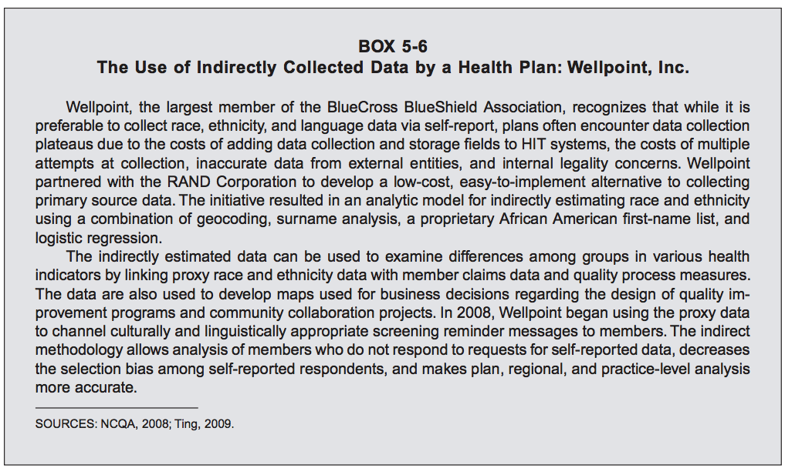
Existing approach: BISG proxy method
“… estimate race and ethnicity using a combination of geocoding, surname analysis, a proprietary African American first-name list …”
“… link proxy race and ethnicity data with member claims data and quality process measures.”
(Nerenz et. al. 2009)

Slide 9
BISG
First developed for auditing fairness in healthcare (Elliott et al. 2008, 2009), later on adopted by regulators in fair lending;
An interim strategy suggested by Institute of Medicine (Nerenz et al. 2009).
CFPB’s analysis based on BISG led to $98 million fine against Ally Bank in 2013;
Biased estimation of disparity and sensitivity to tuning parameter reported in lending applications (Baines and Courchane 2014, Zhang 2016, Chen et. al. 2019).

Slide 10
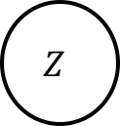
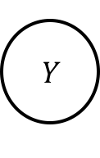

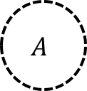
Unmeasured confounders
$$A$$
Classified as advantaged group
race
High SES
Higher
acceptance rate
Spurious
correlation
$$Z$$
$$Y$$
Classified as disadvantaged group
geolocation
Loan acceptance
Low
SES
$$U$$
socio-economic status (SES), e.g., income
Lower
acceptance rate
(Chen, Kallus, Mao, Svacha and Udell 2019)

Slide 11
Preview of our results
Theory: common outcome disparity measures are unidentifiable given unobserved protected class.
Solution: learn all feasible disparity values that agree with data (and optional assumptions).
12

Slide 12
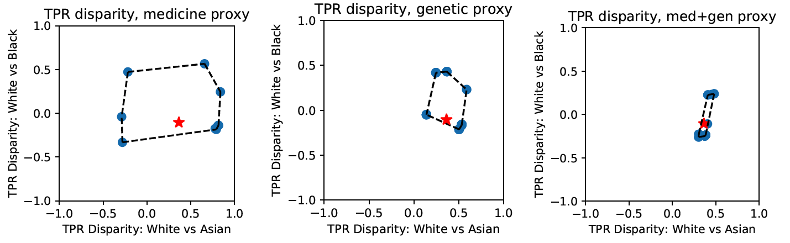
Preview of our results
Theory: common outcome disparity measures are unidentifiable given unobserved protected class.
Solution: learn all feasible disparity values that agree with data (and optional assumptions).
12

Slide 13
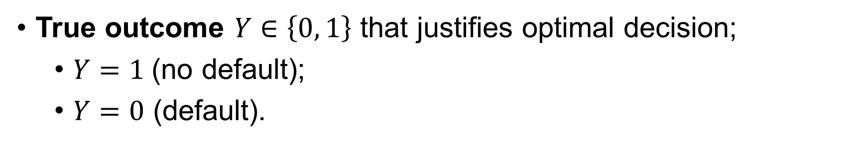
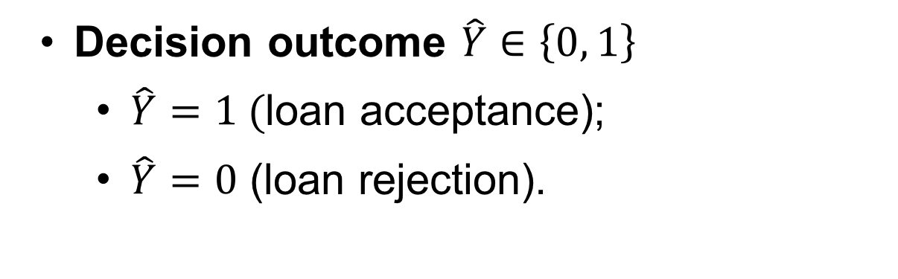
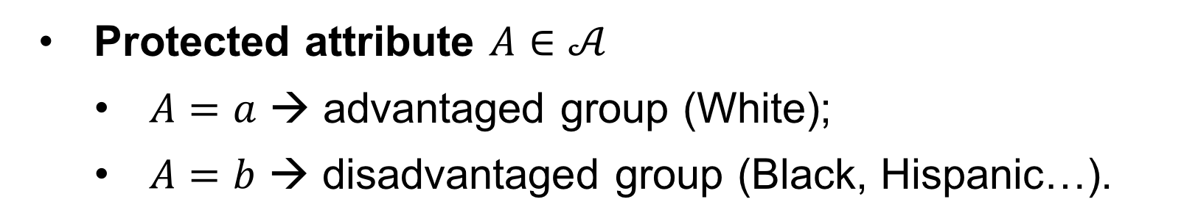
Notation
True outcome $Y∈\left\{0, 1\right\}$ that justifies optimal decision;
$Y=1$(no default);
$Y=0$ (default).
Decision outcome $\hat{Y}∈\left\{0, 1\right\}$
$\hat{Y}=1 ($loan acceptance);
$\hat{Y}=0$ (loan rejection).
Protected attribute $A∈𝒜$
$A=a$ → advantaged group (White);
$A=b$ → disadvantaged group (Black, Hispanic…).
Proxy variables $Z∈𝒵$, e.g., surname and geolocation in BISG.

Slide 14
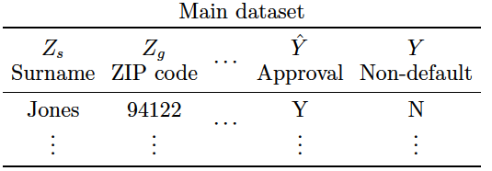
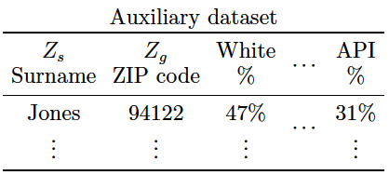
Data Combination
Assumption:
Independent draws from Common distribution
Main dataset
Auxiliary dataset

Slide 15
Disparity measure
Demographic disparity:
True positive rate disparity:
True negative rate disparity
Many more …, but these are not necessarily best measures.
(Hardt et. al. 2016, Berk et al. 2018, Chouldechova 2017, …)

Slide 16

Disparity measure
Demographic disparity:
True positive rate disparity:
True negative rate disparity
Many more …, but these are not necessarily best measures.
Easy to compute if knowing $P\left(Z, A, \hat{Y}, Y\right)$
(Hardt et. al. 2016, Berk et al. 2018, Chouldechova 2017, …)
Problem: only $P\left(Z, A\right)$ and $P\left(Z, \hat{Y}, Y\right)$are available!

Slide 17
Identification under perfect proxy
If the proxy variable $Z$ can perfectly predict either $\left(\hat{Y}, Y\right)$ or $A$, i.e.,
either
or
for almost all
then
or
Disparity measures identifiable
Very Strong Assumption!
Notes:
P(\hat{Y} = \hat{y}, Y = y \mid Z) \overset{a.s.}{\in} \{0, 1\}
P(A = \alpha \mid Z) \overset{a.s.}{\in} \{0, 1\}
P(A = \alpha, \hat{Y} = \hat{y}, Y = y \mid Z)
= P(A = \alpha \mid Z)

Slide 18
General unidentifiability of disparity
Proposition:
Let , and marginal distributions and be given.
If perfect proxy condition does not hold & no extra assumptions, then there exist two different joint distributions that agree with the marginal distributions but give rise to two different values of the disparity measures.
So is it hopeless?

Slide 19
Uncertainty set for joint distributions
Let the distributions and be given.
Law of total probability
Fréchet-Hoeffding
inequality
Equal under perfect proxy
How to effectively use this information?
(Cambanis et al. 1976, Fan et al. 2014)

Slide 20
A weighted formulation for disparity
Recall
Define
Unidentifiable
Identifiable
Law of Total Probability
Fréchet-Hoeffding inequality

Slide 21
Partial identification set for disparity
Denote
Singleton with perfect proxy
Tight partial identification set:
Notes:
\mathcal{W}_{LTP} = \bigg\{w: \sum_{\hat{y}, y} w_{\alpha}(\hat{y}, y, z)P(\hat{y}, y \mid z) = P(\alpha \mid z),
\Delta_{TPRD}(\mathcal{W}_{LTP}) = \{(\mu_{11}(a; w) - \mu_{11}(b; w))_{b \in \mathcal{A}\backslash \{a\}}, w \in \mathcal{W}_{LTP}\}

Slide 22
Smoothness constraint
The partial identification sets defined analogously for
Adding other assumptions are also possible.
Notes:
\mathcal{W}_{Smooth} = \bigg\{w: |w_{\alpha}(\hat{y}, y, z) - w_{\alpha}(\hat{y}, y, z')| \le Ld(z, z')\bigg\}
\Delta_{TPRD}(\mathcal{W}_{LTP} \cap \mathcal{W}_{smooth})

Slide 23
Size of partial identification set
Partial identification (PI) set captures ambiguity in learning disparity based on data and assumptions.
Informative proxies → small PI set;
Strong assumption → small PI set;
Uninformative proxies and weak or no assumptions → large PI set → valuable warning.

Slide 24
Computing PI set
Recall
Consider its support function
which characterizes the convex hull of PI set

Slide 25
Computing PI set
Support function for true positive rate disparity
Apply the Charnes-Copper transformation

Slide 26
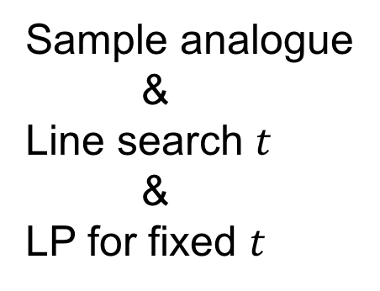
Computing PI set
s.t.
Sample analogue
&
Line search $t$
&
LP for fixed $t$

Slide 27
Data analysis: US mortgage data

Slide 28
Data analysis: personalized warfarin dosage
The most commonly used oral anticoagulant agent, and the optimal dosage can vary drastically across patients.
Strong interest in developing personalized dosage algorithm.
The IWPC dataset contains optimal dosage found by doctors.
Examples include linear regression (Consortium 2009), LASSO (Bastani and Bayati 2015), and decision trees (Kallus 2017), etc.
Racial disparity in the performance of personalized dosage algorithms is reported in the literature (Consortium 2009).
1. https://www.pharmgkb.org/downloads.

Slide 29
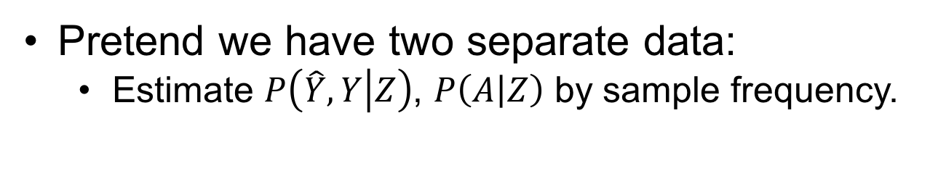
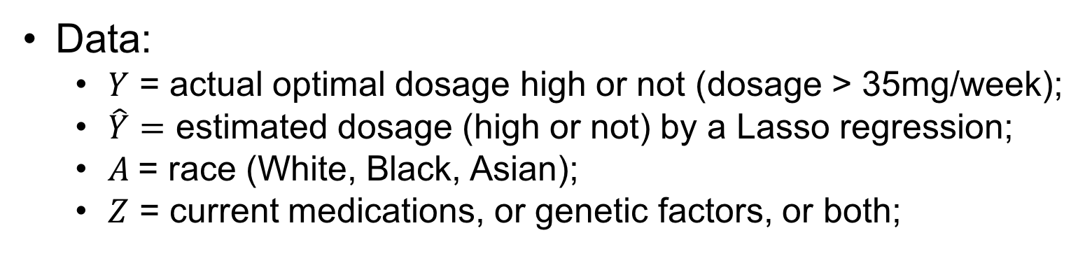
Data analysis: warfarin dosing
Data:
$Y$ = actual optimal dosage high or not (dosage > 35mg/week);
$\hat{Y}=$ estimated dosage (high or not) by a Lasso regression;
$A$= race (White, Black, Asian);
$Z$ = current medications, or genetic factors, or both;
Pretend we have two separate data:
Estimate $P\left(\hat{Y}, Y | Z\right)$, $P\left(A | Z\right)$ by sample frequency.
(Consortium IWP, 2009)

Slide 30
Partial identification set

Slide 31
Proxy strength
Entropy

Slide 32
Proxy strength

Slide 33
Summary
Data combination formulation to analyze proxy methods;
Unidentifiability of disparity measures;
Characterizing the partial identification sets;
Robust disparatity auditing to capture the identification uncertainty.
Limitation: relative simple disparity measures, identical distribution assumption may be violated.

Slide 34
Reference
Kallus, Nathan, and Angela Zhou. "Confounding-robust policy improvement." Advances in Neural Information Processing Systems. 2018.
Chen, Jiahao, et al. "Fairness under unawareness: Assessing disparity when protected class is unobserved." Proceedings of the Conference on Fairness, Accountability, and Transparency. ACM, 2019.
Kallus, Nathan, Xiaojie Mao, and Angela Zhou. "Assessing Algorithmic Fairness with Unobserved Protected Class Using Data Combination." arXiv preprint arXiv:1906.00285 (2019).
Arthur P Baines and Marsha J Courchane. 2014-11. Fair Lending: Implications for the Indirect Auto Finance Market. https://www.crai.com/sites/default/files/publi cations/Fair-Lending-Implications-for-the-Indirect-Auto-Finance-Market.pdf
Yan Zhang. 2016-01. Assessing Fair Lending Risks Using Race/Ethnicity Proxies. Management Science 64, 1 (2016-01), 178–197. https://doi.org/10.1287/mnsc.2016. 2579.

Slide 35
Reference
Consortium IWP (2009) Estimation of the warfarin dose with clinical and pharmacogenetic data. New England Journal of Medicine 360(8):753–764.
Bastani, Hamsa, and Mohsen Bayati. "Online decision-making with high-dimensional covariates." Available at SSRN 2661896 (2015).
Kallus, Nathan. "Recursive partitioning for personalization using observational data." Proceedings of the 34th International Conference on Machine Learning-Volume 70. JMLR. org, 2017.
Fremont, Allen, et al. "When race/ethnicity data are lacking." RAND Health Q 6 (2016): 1-6.
Elliott MN, Fremont A, Morrison PA, Pantoja P, Lurie N (2008) A new method for estimating race/ethnicity and associated disparities where administrative records lack self-reported race/ethnicity. Health services research 43(5p1):1722–1736.

Slide 36
Reference
Elliott MN, Morrison PA, Fremont A, McCaffrey DF, Pantoja P, Lurie N (2009) Using the census bureau’s surname list to improve estimates of race/ethnicity and associated disparities. Health Services and Outcomes Research Methodology 9(2):69.
Nerenz DR, McFadden B, Ulmer C, et al. (2009) Race, ethnicity, and language data: standardization for health care quality improvement (National Academies Press).
Weissman, Joel S., and Romana Hasnain-Wynia. "Advancing health care equity through improved data collection." New England Journal of Medicine 364.24 (2011): 2276-2277.

Slide 37
Chen, Kallus, Mao, Svacha and Udell. “Fairness under unawareness: Assessing disparity when protected class is unobserved.” ACM FAT*, 2019.
Kallus, Mao, and Zhou. “Assessing Algorithmic Fairness with Unobserved Protected Class Using Data Combination.” Major revision in Management Science Special Issue on Data-Driven Prescriptive Analytics. 2019.
Contact: xm77@cornell.edu Website: https://xiaojiemao.github.io/
Thank you!

